Slide 1

RAVEN Introduction
Presenter: Cristian Rabiti

Slide 2
RAVEN Structure

Slide 3
Capabilities vs. Needs
Algorithms | User Cases
 | Uncertainty Quantification | Risk Analysis | Risk Management | Validation | Experiment design | Optimization
Distribution | Yes | Yes | Yes | Yes | Yes | Yes
Sampling | Yes | Yes | Yes | Yes | Yes | Yes
Surrogate Models | Yes | Yes | Yes | Yes | Yes | Yes
Statistical post processing | Yes | Yes | Yes | Yes | Yes | Yes
Reliability Surface |  | Yes | Yes
Data mining |  | Yes | Yes
Analytical distribution comparison (ongoing) |  |  |  | Yes | Yes
Minimization Algorithms (ongoing) |  |  | Yes |  | Yes | Yes

Slide 4
Distributions
Distribution describe the statistical behavior of input parameters

Slide 5
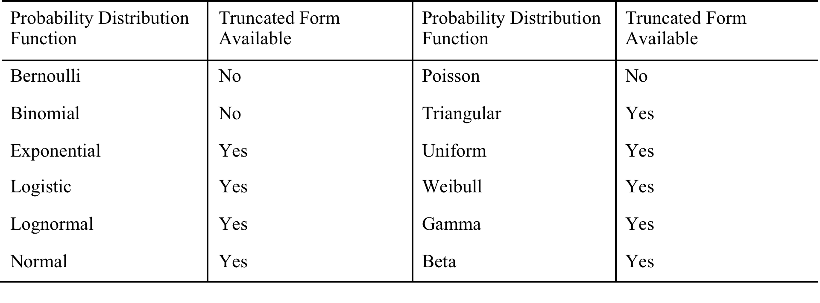
Standard Distributions
Most common used 1D distributions

Slide 6
N-Dimensional Distributions (Unique capabilities)
Import from file for custom N-dimensional distributions:
N-dimensional splines on Cartesian grids
Inverse weight interpolation
Micro sphere interpolation
Sampling of N-dimensional distributions by not biased random inversion

Slide 7
Distribution Input
Run Info
Files
Models
Distribution
Functions
Samplers
Steps
Database
<Distributions>
<Normal name='x_distrib'>
<mean>2</mean>
<sigma>0.2</sigma>
</Normal>
</Distributions>

Slide 8
Sampler
Samplers determine the strategy for exploring the input space

Slide 9
Samplers (non-Adaptive)
RAVEN supports many non-adaptive samplers
Monte Carlo
Grids:
equal-spaced in probability
equal-spaced in value
mixed (probability, custom, value)
Custom (used provided values/probability)
Stratified (LHS type)
equal-spaced in probability
equal-spaced in value
mixed (probability, custom, value)
Custom (used provided values/probability)
Generalized stochastic collocation polynomial chaos
A different sampling strategies can be associated to each variable separately

Slide 10
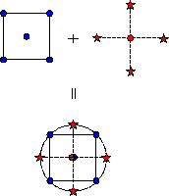
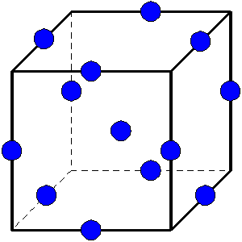
Samplers (non-Adaptive) Cont.
Factorial Designs:
General Full Factorial (grid)
2-Level Fractional-Factorial
Plackett-Burman
Response Surface Designs:
Box-Behnken
Central Composite
Central Composite
Box-Behnken

Slide 11
Dynamic Event Trees (DET)
Sampling is decided beforehand for “control variables”
the corresponding simulation is run only if the physics triggers the control variable
DET can be used in a mixed fashion with any of the other sampler
Probability
Pressure
Time
Stochastic system could not be fully controlled by the initial condition
Pipe failure pressure
Failure @66% CDF
Cumulative Distribution Function (CDF)
Failure @33% CDF
Pressure
Pressure
Time
Pipe failure pressure
DET available with RELAP5-3D, MAAP, RELAP-7
Time

Slide 12
Adaptive Sampler: Reliability Surfaces Finder
The sampler seeks to determine a region in the input parameter space for which a given condition is satisfied
Used to determine operative safe regions
Performance optimization
Trying to avoid high temperature regions
High Risk Direction
Excessive Temperature Region
Risk Neutral Direction

Slide 13
Adaptive Stochastic Polynomials
Valuable when the parametric space is <10-15 variables
Selectively choose the sampling points to construct a polynomial representation of the system response
The plots shows how many evaluations are necessary to assess the mean of a variable depending from five stochastic parameters
Monte Carlo
Adaptive

Slide 14
Input Sampler
Run Info
Files
Models
Distribution
Functions
Samplers
Steps
Database
<Samplers>
<MonteCarlo name='MCsampler'>
<samplerInit><limit>5000</limit></samplerInit>
<variable name='x’>
<distribution>x_distrib</distribution>
</variable>
</MonteCarlo>
<Grid name=’GridSampler’>
<variable name=‘x1’>
<distribution>x1_distrib</distribution>
<grid type=‘CDF’ construction=‘equal’ steps=’10’>0.0 1.0</grid>
</variable>
<variable name=‘x2’>
<distribution>x2_distrib</distribution>
<grid type=‘value’ construction=‘equal’ steps=‘8’>0.1 0.9</grid>
</variable>
</Grid>
</Samplers>

Slide 15
Queuing
Queuing strategies is used to take advantage of modern high performance computing

Slide 16
Parallel Environment
Modern codes are already parallel using MPI and multithreading
RAVEN manages concurrent runs of already parallel codes by sub-process (single nodes) or interfacing with the queuing software present in the environment (PBS professional implemented, API available for other software)
Job 1
Thread 1
MPI 1
Job 2
Thread 2
RAVEN
JobHandler
MPI 2
Job ...
Thread ..
MPI ..
Thread J
Job N
Batch Size
MPI M

Slide 17
Input: Step and RunInfo
Run Info
Files
Models
Distribution
Functions
Samplers
Steps
Database
<Runinfo>
<WorkingDir>./myDir</WorkingDir>
<Sequence>runMC</Sequence>
<batchSize>10</batchSize>
</Runinfo>
<Steps>
<MultiRun name=‘runMC’>
<Input class=‘Files’ type=‘’ >inputFile.i</Input>
<Model class=‘Models’ type=‘Code’ >RELAP5-3D</Model>
<Sampler class=‘Samplers’ type=‘MonteCarlo’>MCsampler</Sampler>
<Output class=‘DataObjects’ type=‘PointSet’ >outMC</Output>
</MultiRun>
</Steps>

Slide 18
Models API
Model APIs is the way in which RAVEN access a physical model

Slide 19
Models
RAVEN support three different models:
ROM (Reduced Order Models). This type of models are constitute by already trained supervised learning algorithms (RAVEN can use data sets for their training)
External Models. External models are made of python code that use directly the “model” class
External codes. These are classical third parties codes. The API requires the implementation of writing/reading to/from the input/output files

Slide 20
Available ROMs
Nearest neighbor (KD-Tree based)
Support vector machine:
Polynomial kernel
Gaussian Kernels
Radial basis functions
Micro Sphere
Inverse Weight
N-Dimensional spline
Gaussian process
Polynomial (stochastic and not)
Linear regressors
Many more (http://scikit-learn.org/stable/supervised_learning.html)
Ensemble models

Slide 21
Model APIs
ROM: Supervised Learning algorithms
Base Model Class
ROM API. This API is build to match the standard interface to use the supervised algorithms of the scikit-learning library
External Models
The model in python is directly callable form RAVEN
Code API. This API requires the capability to write code input files and read output files. A generic implementation using wild card is available
MOOSE based applications
External Code
Generic interface
Melcor
Relap5-3D
MAAP

Slide 22
Ensemble model
Multiple “models” can be assembled together and treated as a single one
Models can be completely heterogeneous (code, external models, ROM)
RAVEN acts as a hub for the information exchange
Information passed between “models” could be:
Set of lump values
Set of time series (being currently finalized)
Ensemble model
Model
Model
Model
Notes:
Sometimes, multiple models need to interface with each other since the initial conditions of some are dependent on the outcomes of others

Slide 23
Input: Models
Run Info
Files
Models
Distribution
Functions
Samplers
Steps
Database
<Models>
<ExternalModel name=‘PythonModule’ subType=‘’ ModuleToLoad=‘./externalModel’>
<variables>x,y</variables>
</ExternalModel>
</Models>

Slide 24
Data Structure
RAVEN has its own internal data structure but also used HDF5 and CSV

Slide 25
Input: Data
Run Info
Files
Models
Distribution
Functions
Samplers
Steps
Database
<DataObjects>
<PointSet name=‘outSampler’>
<Input>x</Input>
<Output>y</Output>
</PointSet>
</DataObjects>
<Databases>
<HDF5 name='out_ROM4_db’ readMode =‘overwrite’ />
<HDF5 name='out_ROM5_db’ readMode =‘overwrite’ directory='/pathToDatabase/’/>
<HDF5 name='out_db' readMode =‘read’ directory='/pathToDatabase/'/>
</Databases>
Database that is going to be created
Existing database that is going to be retrieved

Slide 26
Post Processing
Interpretation of large data is a new challenge in large probabilistic analysis

Slide 27
Statistical Post Processing
Statistical characterization of the output (uncertainty propagation)
Mean
Sigma
Skewness (asymmetry)
Kurtosis (more/less peaked than a standard normal)
Input/output relationship (ranking/sensitivity)
Correlation matrix
Covariance matrix
Sensitivity matrix (multidimensional linear regression)
Normalized sensitivity matrix (% change of the response / % change in the answer)

Slide 28

Classical Data Mining
RAVEN gives access to several data mining algorithms for data post-processing via implementation of APIs between RAVEN and Scikit-learn*
Cardinality Reduction algorithms aim to recognize commonalities among the data - Clustering, Gaussian Mixture Models, etc.
Dimensionality Reduction algorithms are used to reduce the number of degrees of freedom in the data under consideration – Manifold Learning, Decomposing Signals in Components, etc.
RAVEN extends all the data mining algorithms to perform time dependent data mining
*http://scikit-learn.org

Slide 29
Input: Basic Statistics
Run Info
Files
Models
Distribution
Functions
Samplers
Steps
Database
<Models>
<PostProcessor name='StatisticsOutput’ subType='BasicStatistics’>
<what>all</what>
<parameters>y1,y2,y3,y4,y5</parameters>
</PostProcessor>
</Models>
<Steps>
<PostProcess name='PP'>
<Input class='DataObjects’ type=’PointSet’ >outMC</Input>
<Model class='Models' type='PostProcessor’>StatisticsOutput</Model>
<Output class='Files' type='' >output_basicStatistics.csv</Output>
</PostProcess>
</Steps>

Slide 30
Examples

Slide 31
Probabilistic Analysis Results
The following table summarizes the results obtained with different sampling methodologies. Overall we obtained a good agreement
Sampler | Settings | Failure Probability (-)
Monte Carlo | 1224 runs | 1.31E-2
Grid Sampler | Equally value spaced 6x6x6x6= 1296 | 1.33E-2
Latin Hyper Cube | 1224 equally probability spaced | 1.34E-2
Monte Carlo
Grid
LHS

Slide 32
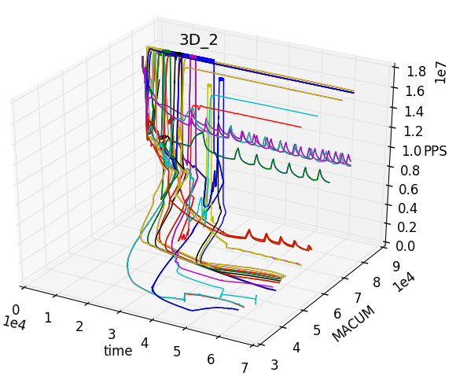
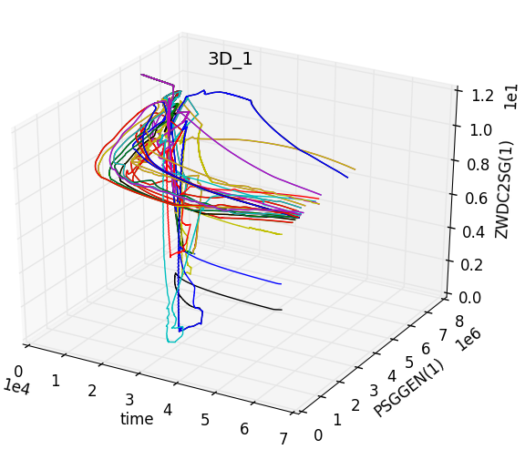


MAAP
Dynamic Event tree coupling available with MAAP
126 branches simulated
54 completed histories
7 out of 54 histories ends due to the occurrence of “core uncovery”
“Core uncovery time” ranges from 5257 s to 12853 s
Trajectories of the system evolution with respect different figure of merits: mass of water in the accumulators tanks, primary system pressure, steam generator 1 pressure, collapsed water level into the core

Slide 33
Uncertainty Quantification
Demo: BWR Station Black Out analysis
Code: RELAP5-3D (10,000 runs)
Sampled variables:
Elapsed time before Diesel Generation loos
Diesel Down time
Power Level
Clad Temperature (system Output):
Entry | Monte Carlo
Mean: | 2.32E+03
Sigma: | 9.05E+02
Kurtosis: | -1.54E+00
Median: | 3.09E+03
Skewness: | -5.25E-01

Slide 34
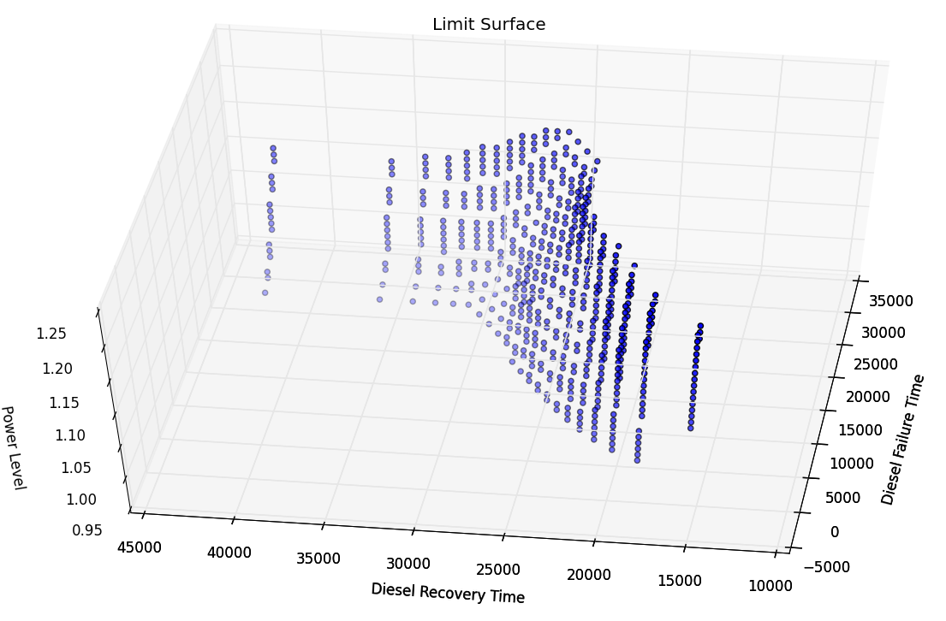
Risk Management: Reliability Surface
Safe Region
Failure Region
Seeking the combination of parameters (axis) that allows not to exceed the maximum clad temperature

Slide 35
Workflows
Simulation 1
Simulation 2
Sampler
+
Distributions
Sampler
+
Distributions
Model (code)
ROM Training
Model (code)
Data Base
Post Processing
Post Processing

Slide 36
Comparison vs ROM
Statistical figures for max clad temperature:
Entry | Original | Surrogate
Mean: | 2.3296E+03 | 2.3103E+03
Sigma: | 9.0559E+02 | 8.4599E+02
Kurtosis: | -1.547E+00 | -1.4497E+00
Median: | 3.092E+03 | 2.683E+03
Skewness: | -5.256E-01 | -5.0662E-01
Failure Pb | 60.99% | 60.82%
The matching of the results between the Monte Carlo Sampling on the RELAP5-3D code and the build surrogate confirm the good training set
New input distributions could be tested without re-running the original code but using the ROM

Slide 37
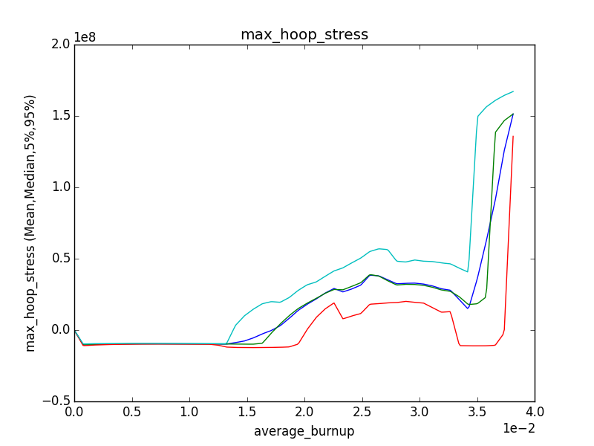
Time Dependent Statistics: Fuel Performance
95% percentile
Mean
Median
5% percentile
Max hoop stress during transient as a function of burn up

Slide 38
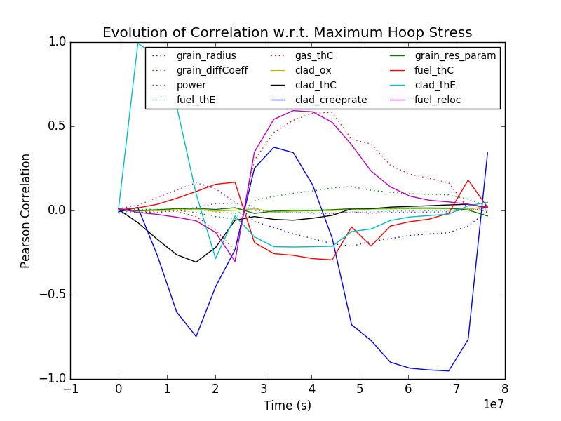
Time Dependent Relational Analysis
The correlation analysis reveals how much each input is linearly related to the input space
Changes in the correlation coefficient usually indicate a change in the dominating physics

Slide 39
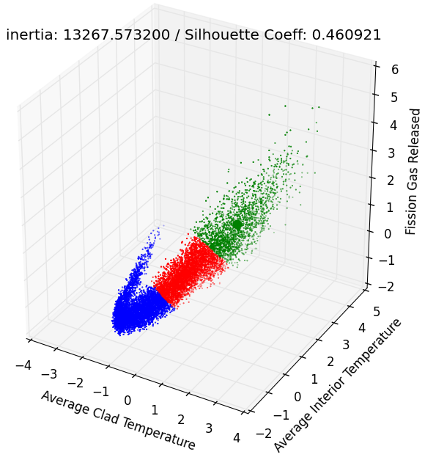
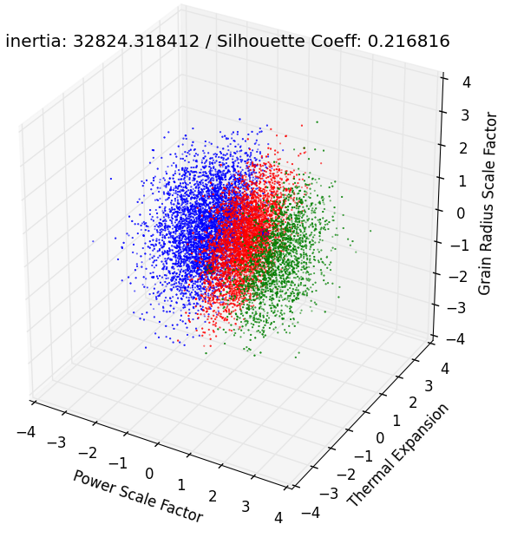
Clustering to Analyze Behavior Drivers (Fuel Performance
Input Parameters
Power scaling factor of the core
Scaling factor of the grain size in the fuel microstructure
Thermal expansion coefficient of the fuel
Output Parameters
Average Clad Temperature
Average Interior Temperature
Fission Gas Released
Clustering structure in the output space when projected in the input space reveals that the power is the discriminant driver of the cluster structure

Slide 40
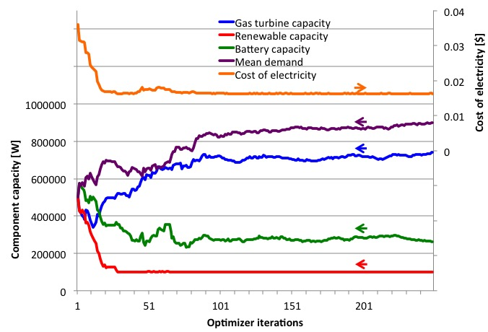
Stochastic Optimization
Optimization of electricity supply mix under stochastic wind supply

Slide 41
How Can I use it (Risk Management)?
Create an ensemble model using several codes
Compute the failure probability of the ensemble system using the limit surface
Good enough?
Yes, stop
No, go on
Cluster the system evolution to identify if there where cliff edge effects
Yes: determine the discriminant point and improve design
No: perform sensitivity analysis: move the mean values or decrease uncertainty on the input space

Slide 42
How Can I use it (Risk Differential Analysis)?
Run dense sampling
Train a ROM
Sample the ROM changing failure probability of each component (from 100% failure rate to 0%) to evaluate the single contribution and the global impact

Slide 43
Design of Experiment
Model the experiment
Run the experiments with input uncertainties
Use as figure of merits the experimental readings
Use dimensionality reduction in the output space (experimental readings) to determine redundancy in the experimental sensors (remove redundant readings –save money-)
Analyze the sensitivity of the experimental reading to variation in the input space to:
Eliminate the one too sensible to not controllable uncertainties
Eliminate the one that are not sensitive to the model parameters to be validated

Slide 44
RAVEN Status
Code available in beta release
User manual
Theory/guidelines manual
Possible open source coming soon
Supported platforms:
Linux
Mac OS
Windows

